Slide 1
BlockChain Decentraliszed Stock ExchangeApplication：DEX
Project Group 27
Yiming Ge (z5341323)
Haohua Fang（z5338678）
Dongfei Fan (z5211565)
Faith Ko (z5437801)

Slide 2
Chosen domain, challenges and problems
01
04
2 architectural designs and comparison
02
05
Proposed development plan
FRs and NFRs
03
Suitability of blockchain technology

Slide 3

01
Chosen domain, challenges and problems

Slide 4

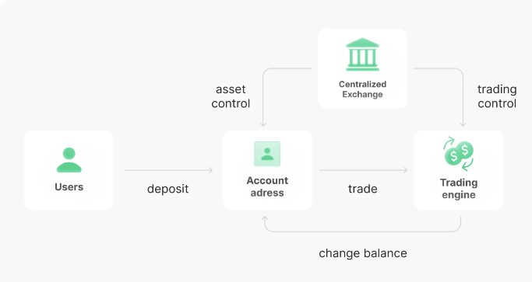
Chosen domain, challenges and problems
Chosen Domain
Challenges and problems
Decententized Exchange (DEX)
FTX scam (Nov 2022)
Problem of CEX (Centralization Exchange)
Lack of regulation
Exchange process and trade account are central control by the exchange platform
Trust problem
Enforcement of regulation
Notes:
FTX Exchange was a leading centralized cryptocurrency exchange platform, the world's third-largest in July 2021, specializing in derivatives and leveraged products, spot markets in more than 300 cryptocurrency trading pairs such as BTC/USDT, ETH/USDT, XRP/USDT, and its native token FTT/USDT.
In 2 Nov, a crypto news site CoinDesk that revealed that Alameda Research, which run by the same owner of FTX, held a position valued at $5 billion in FTT, which is not a fiat currency (like) or other cryptocurrency.
By the next day, FTX was experiencing a liquidity crisis. Customers of FTX demanded withdrawals worth $6 billion in the days. As they afraid what if FXT fall and the value of FTT drop to 0.
The owner of FTX try to claim down those customers who request to withdrawal money, but fail. At the same time, there were rumours of the boss fleeing to Argentina, and some other said there were around $600m of USD in FTT was missing.
Maybe I can say luckily, the owner has been arrested around 1 month later and charged in numbers of chargers include fraud, money laundering and other charges over the collapse of the now-bankrupt exchange.
However, it also highlight the fundamental problems of encryption ecosystem supported by centralized trading platforms.
So, how does exchange work in CEX?
- Centralised exchanges go much further by offering a one-stop-shop service.
- They aren’t just an intermediary between buyers and sellers. Rather than self-custody, they act as custodian, holding cryptocurrency on customers’ behalf.
- Therefore, Crypto investors register on the exchange platform and pass through the verification procedure.
- Then, the user’s cryptocurrency or fiat currency (like USD, EUR) is deposited into the exchanger’s cryptocurrency wallet with the help of an exchange service from the fiat currency on their bank card to any cryptocurrency directly on the exchange’s website.
- After all these stpes, crypto users can search for the trading pairs they want (for example, Bitcoin to Stablecoin USDT) and buy Bitcoin or any other cryptocurrency with their U.S. dollars.
- All trading pairs of interests exist on that exchange, and the amount of transaction will store in exchange platform.
Lack of regulation:
- Some ppl may think Cryptocurrency exchanges are similar to like traditional stock exchanges
o You deposit money in a bank, and use these money to buy stock, and the stock hold in your account. When we sell the stock, money goes back to our bank account
- However, in face, Stock exchanges are both highly regulated and help regulate share trading.
- But, Cryptocurrency exchanges, are virtually unregulated and serve no regulatory function to exchange platform itself.
- On the other word, they’re just private businesses who exchange platform centralise owned and operated the exchange and your wallet.
- It runs well at the good days, but your money in the wallet may not be safe when the exchange platform has problem.
That is Decentralized Exchange (DEX) comes up to solve the issue.
- Decentralised exchanges are essentially online platforms to connect the orders of buyers and sellers of cryptocurrencies by smart contract.
- DEX are just there to facilitate trading.
- You still need to hold cryptocurrencies in your own wallet.
- Our teammate will further explain DEX architectures later on

Slide 5
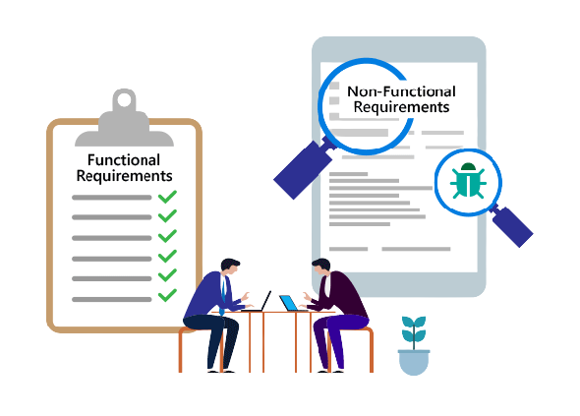
02
Functional and Non-functional Requirement

Slide 6

Functional and Non-functional Requirement
Functional Requirement
User Registration and Authentication
Order Placement and Execution
Fund Deposits and Withdrawals
Non-functional Requirment
Performance
Compliance and Regulations
Security
Notes:
What are the functional requirement and non-functional requirement of DEX
- User Registration and Authentication: The platform should provide a seamless user registration process, allowing individuals or entities to create accounts and authenticate their identities. This requirement ensures the security and integrity of the platform by verifying the users' identities and enabling access control mechanisms.
- Order Placement and Execution: The exchange platform should facilitate the placement and execution of buy and sell orders. It should allow users to enter their orders, specify the desired price and quantity, and provide mechanisms to match buyers with sellers efficiently. The platform should handle order matching, execution, and settlement processes accurately and in a timely manner.
- Fund Deposits and Withdrawals: The platform must support secure and reliable mechanisms for users to deposit funds into their accounts and withdraw them when needed. It should integrate with various payment systems, banks, or other financial institutions to enable smooth transactions. The exchange platform should ensure the proper custody and safekeeping of user funds and provide transparency in financial transactions.
Non-functional requirement
- Performance: The platform should be highly responsive and perform efficiently, even under heavy loads and peak trading periods. It should be capable of handling a large number of simultaneous users, processing transactions quickly, and providing real-time updates of market data. Low latency and high throughput are critical to ensure a smooth trading experience.
- Compliance and Regulations: Exchange platforms often operate in a highly regulated environment. They need to adhere to legal and regulatory requirements specific to the jurisdictions they operate in, such as anti-money laundering (AML) and know-your-customer (KYC) regulations. The platform should have compliance features and reporting mechanisms to ensure adherence to these regulations, promoting transparency and accountability.
- Security: An exchange platform must prioritize security to protect user information, transactions, and assets. It should implement robust authentication and authorization mechanisms, encryption protocols, and security best practices. Measures such as two-factor authentication, secure socket layers (SSL), and regular security audits should be in place to mitigate the risk of unauthorized access, data breaches, and cyberattacks.

Slide 7
03
Why use blockchain

Slide 8
Analysis
Automation
Transparency
Security
Use of smart contract would make the trade more efficient
Everyone is the supervisor
The data can’t be altered and is encrypted
Notes:
https://www.ibm.com/topics/benefits-of-blockchain#:~:text=Blockchain%20increases%20trust%2C%20security%2C%20transparency,cost%20savings%20with%20new%20efficiencies.&text=Blockchain%20for%20business%20uses%20a,accessed%20by%20members%20with%20permission. Let me talk about why we choose blockchain to implement our application.
Fiest, automation. When using the blockchain, transactions can be automated with “smart contracts,” which increase the efficiency of the trade process. As the smart contracts would reduce human intervention as well as reliance on third parties to verify that terms of a contract have been met.
About transparency, blockchain uses a distributed ledger, transactions and data are recorded identically in multiple locations. All network participants with permissioned access see the same information at the same time, which providing full transparency. And all transactions are recorded immutably, and are time- and date-stamped. This enables members to view the entire history of a transaction and virtually eliminates any opportunity for fraud.
For the security, by creating a record that can’t be altered and is encrypted end-to-end, blockchain helps prevent fraud and unauthorized activity. Information is stored across a network of computers rather than a single server, making it difficult for hackers to view data.

Slide 9
04
2 architectural designs and comparison

Slide 10
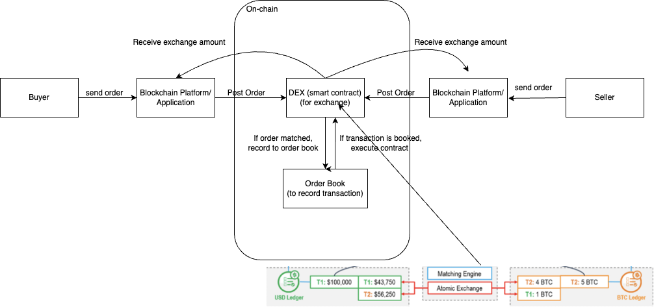
Architecture 1: Alternative Architecture
A buyer is usually a person or entity buying a token or cryptocurrency，while seller is a person or entity selling their cryptocurrency or token.
DEXs utilize blockchain technology to enable trustless trading, where transactions are executed directly between users' wallets through smart contracts.
Blockchain platforms in DeFi facilitate trustless, decentralized, and transparent financial transactions through the use of smart contracts, ensuring security and enabling interoperability among different applications.
Order books in DeFi serve as central components for matching buy and sell orders, facilitating price discovery, liquidity provision, and market transparency in decentralized exchanges.
Notes:
In this process, buyers and sellers access DEX through blockchain platforms and applications, and the dex submits buyer and seller orders in order books, which record the prices and quantities of different assets. When the buy and sell orders are matched, the transaction is executed and completed on the blockchain through the smart contract, the ownership of the asset is transferred from the seller to the buyer, and the details of the transaction are recorded in the user ledger, ensuring the transparency, security and incorruptibility of the transaction Tampering. The entire process eliminates the need for intermediaries, enabling decentralized, transparent and reliable financial transactions.

Slide 11
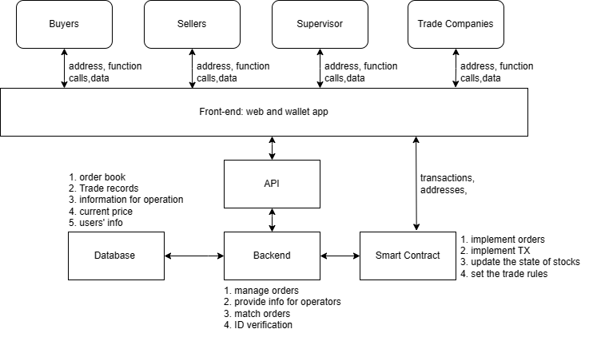
Architecture 2: Main Architecture
Overview
1. Traders’ computers store balance, history, private/public key. They can submit TX to the backend.
2. The backend verifies ID, provide the price and implement TXs as the smart contract. It may also calculate the suitable price and provide the intermediary wallet if necessary.
3. Smart contract stores the TX rules and update the state of the chain.
4. Database stores all off-chain data, such as the order book and the current price.

Slide 12
Advantage and Disadvantage
Alternative Architeture:
Pros:
Pure experience of decentralised app:
1. Great privacy protection and censorship resistance.
2. Easy to audit and supervise.
Cons:
Over-reliance on the chain:
1. Difficult to maintenance and difficult to use.
2. The performance may run down if too much data are on chain.
Main Architeture:
Pros:
Combine the benefit of on-chian and off-chain:
1. Better user experience and easy to use.
2. Better scalability and easy to maintance.
Cons:
Require the centralised facilities:
1. Privacy and supervision.
2. More cost for running the facility.

Slide 13
Comparison and Conclusion
Even though the first method has some advantages on privacy,transparency and decentralization.We are still willing to choose the second method as our main architecture because off-chain is very important in DeFi, providing scalability, faster processing times, and lower costs.
This approach also provides the operational convenience of traditional financial systems while integrating the benefits of blockchain via smart contracts.But It is more complicated for customers to use the first method,affecting the user's trading experience.
Notes:
纯粹，硬核，难以让客户信任，难以推广。开发者很难获利

Slide 14
05
Proposed development plan

Slide 15
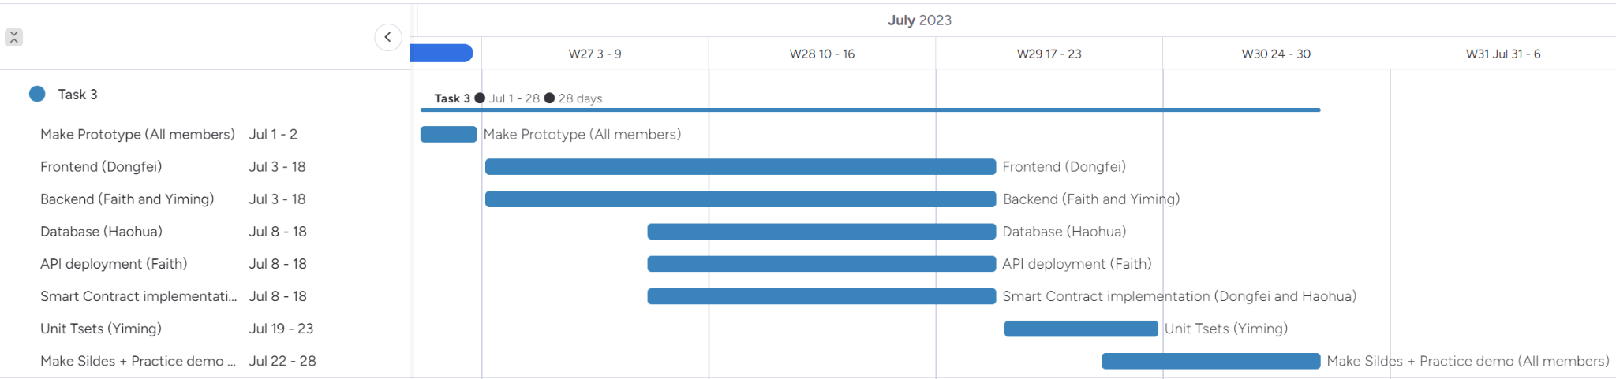
OUR PLANS
Blockchain Platform: Ethereum
Frontend: ReactJS
Backend: Python Database: mySQL
Notes:
BC platform you plan to use, other tools/libraries Timeline for Task3

Slide 16
Thank You

